Slide 1
Altadena Street Lighting
Presented by Victor Le and Erick Guzman
Altadena Heritage Meeting September 15, 2022

Slide 2
Agenda
County Lighting Districts (Erick)
Installing Streetlights (Erick)
Codes/Standards/Guidelines (Victor)
Lighting Design (Victor)
Streetlight Acquisition (Erick)
LED Conversion (Erick)
Request for Services (Erick and John)
Q&A (All)

Slide 3
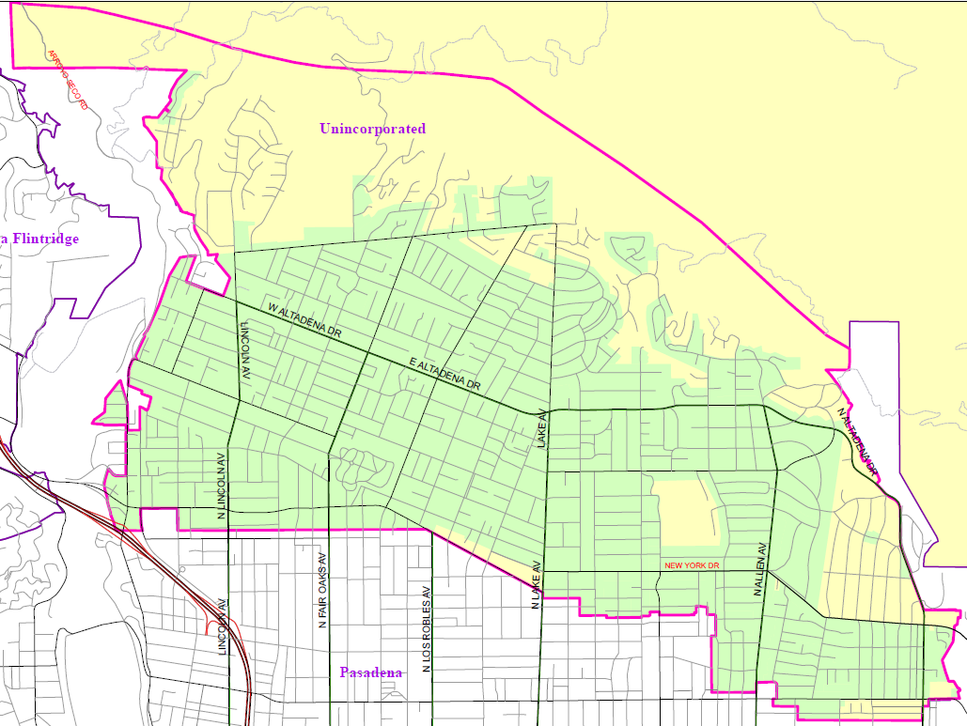
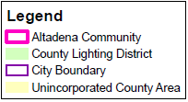
What are CLDs?
County Lighting Districts (CLDs)
Special benefit districts
CA Streets and Highways Code
Improvement Act of 1911
Landscape and Lighting Act of 1978
Streetlight Funding Mechanism
County-administered CLDs
Unincorporated areas
Sixteen cities
Administration
Annexing territories
Collecting assessments
Fund Services

Slide 4
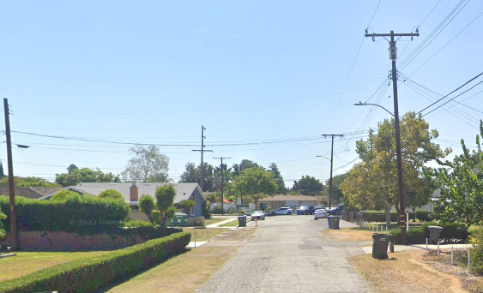
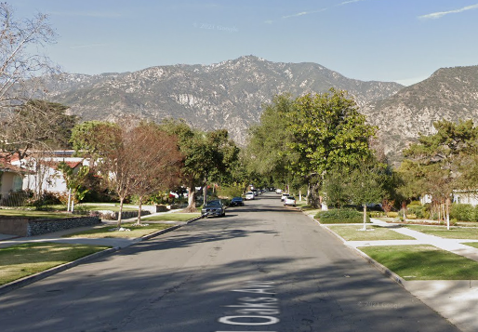
Installing Streetlights
Developments
County code requires installation of streetlights as condition of development
Developments are Annexed into the CLD to fund the ongoing O&M
Resident Requests
Prelim Design
Constructability
Annexation Process
Community meeting
Circulate Petition (>60%)
Final Design Process
Construction
Acceptance
Improved
Un-Improved

Slide 5
Street Lighting – Planning/Guidance Documents
The County does not have a standalone Master Lighting Plan document. The design and installation of streetlights are guided by a combination of State law, national or industry standards/recommendations, County ordinances, and accepted engineering practices.
California Streets and Highways Code
American Medical Association’s Recommendation (2016)
International Dark-Sky Association
Rural Outdoor Lighting District Ordinance (Title 22.80)
Community Standard Districts (Title 22.300)
Illuminating Engineering Society (IES)
Procedures for the Preparation of Streetlight Plans
Notes:
California Streets and Highways Code​
Governs the annexation process and use of CLD funds.​
​
American Medical Association’s Recommendation (2016)​
Provides guidance on the proper use of LED lighting to reduce human and environmental effects.​
​
International Dark-Sky Association​
Provides guidance on the proper use of outdoor lighting to reduce light pollution.​
​
Rural Outdoor Lighting District Ordinance (Title 22.80) ​
Supplemental district that restricts the installation of new streetlights in rural areas to preserve the nighttime environment​
​
Community Standard Districts (Title 22.300) ​
Supplemental District that allows for the use of decorative streetlights in new installations (aesthetics only). Altadena’s CSD does not require decorative streetlights. ​
​
Illuminating Engineering Society (IES)​
The recognized technical and educational authority on illumination and national lighting standards.​
​
Procedures for the Preparation of Streetlight Plans ​
Includes IES national lighting standards for minimum roadway illumination and uniformity levels.

Slide 6
Basic Lighting Standards
In August 1963, the Board of Supervisors of the County of Los Angeles adopted a resolution
requiring the levels of illumination recommended by the Illuminating Engineering Society (IES).
Street Classification | Curb to curb Width | Minimum Average Footcandles | Maximum Uniformity Ratio
Major Intermediate | 84’ | 1.4 | 3
Collector Intermediate | 64’ | 0.9 | 3
Local Residential | <40’ | 0.4 | 6
Notes:
Lake Avenue
Altadena Drive
El Molino Avenue

Slide 7
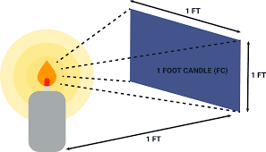
Footcandle
A unit of luminance (light intensity).
The amount of light a candle produces as observed in a square foot, 1 foot away.

Slide 8
Uniformity Ratio
The ratio between the brightest point and the darkest point.
Represents how equally distributed the light is, with 1 being perfectly uniform.

Slide 9
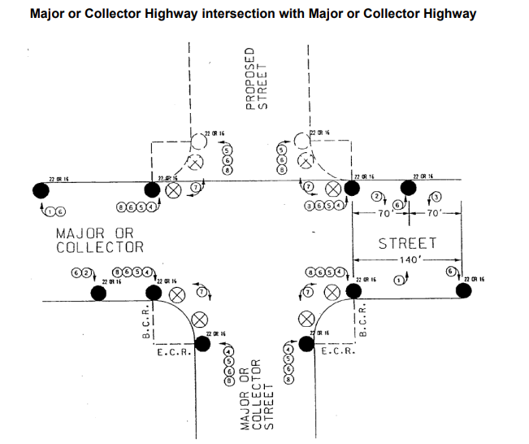
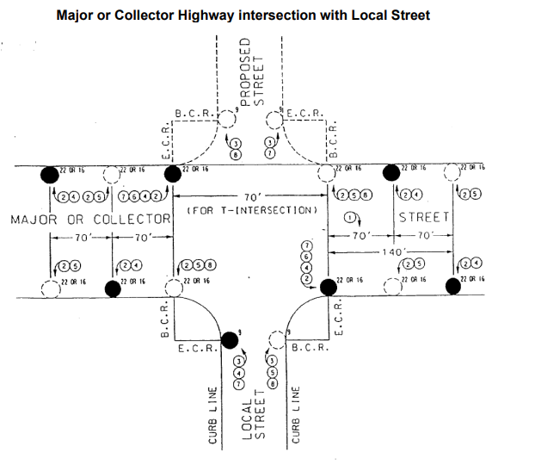
Intersection Lighting

Slide 10
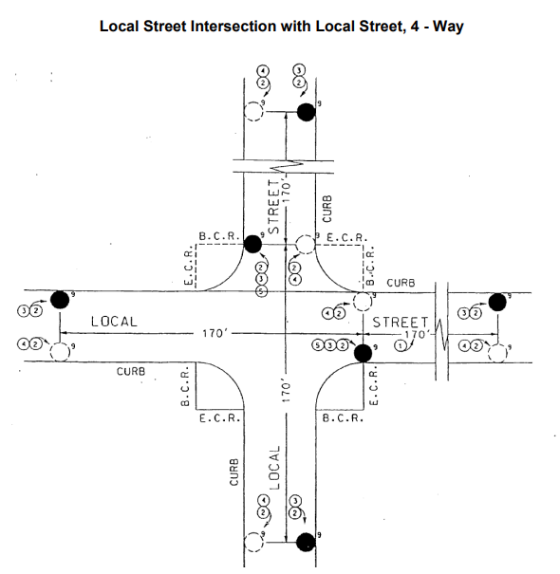
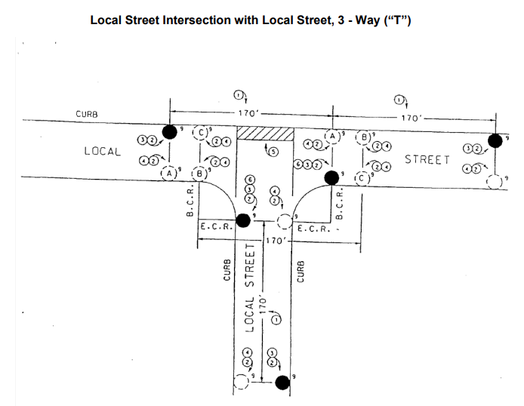
Intersection Lighting

Slide 11
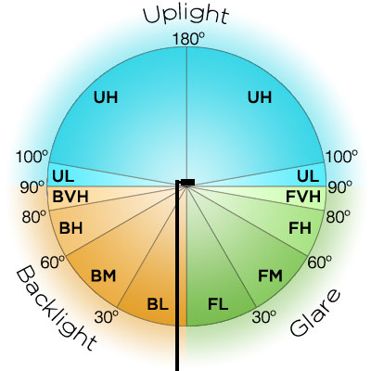
Light Trespass
BUG Rating (0-5):
Backlight is the light directed behind.
Up light is light directed upward.
Glare is the light directed forward.
IES Standards
Wattage equivalent | Backlight | Up light | Glare
100W | 1 | 0 | 2
150W | 2 | 0 | 2
200W | 2 | 0 | 3
250W | 3 | 0 | 3

Slide 12
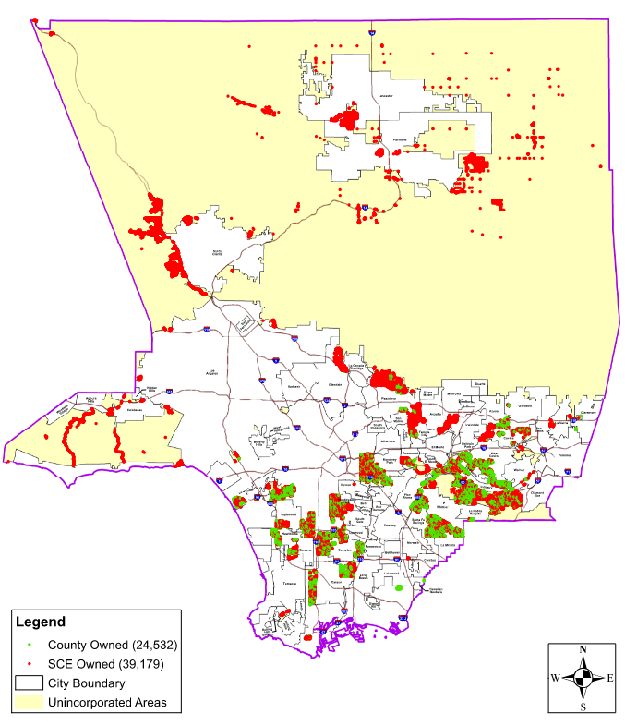
Streetlight Inventory and Acquisition
≈ 60,000 Streetlights
Across 80+ Communities
County-owned ≈ 26,500 (44%)
SCE-owned ≈ 33,500 (56%)
Anticipated Final Split ≈ 50/50

Slide 13
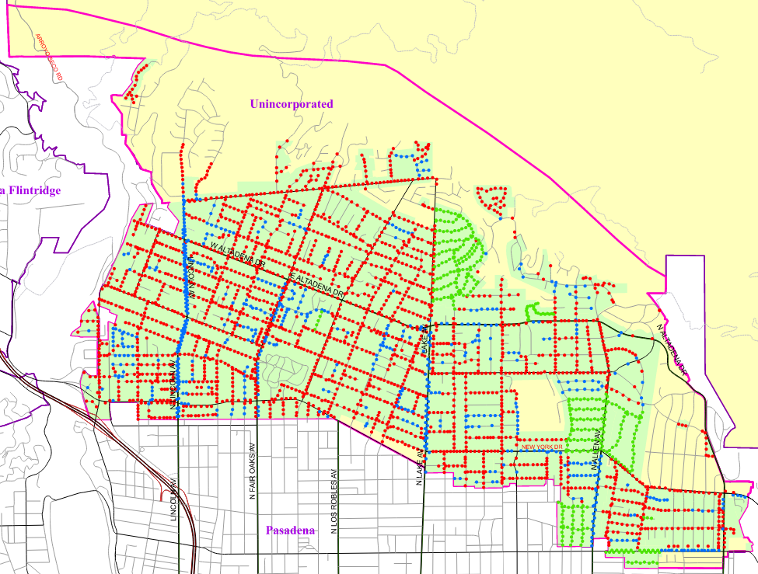
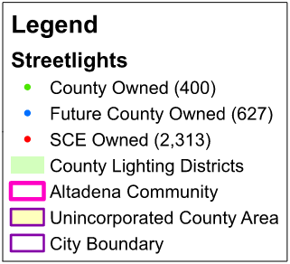
Altadena Streetlight Inventory (By Ownership)
Pole Ownership (after acquisition)
≈ 3,340 Streetlights
County-owned ≈ 1,027 (31%)
SCE-owned ≈ 2,313 (69%)
Pole Material
Wood ≈ 2537 Poles (76%)
Concrete ≈ 680 Poles (20%)
Steel ≈ 123 Poles (4%)

Slide 14
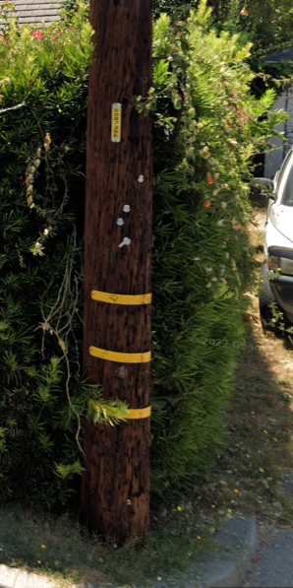
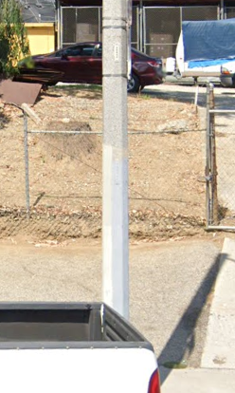
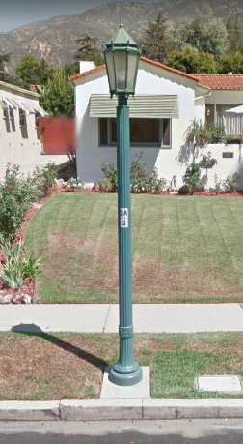
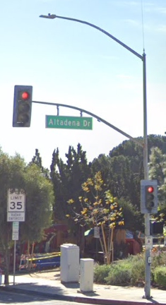
Streetlight Maintenance
SCE-Maintained
County-Maintained
NOTE: Pole with 2 tags or no tag, Contact County

Slide 15
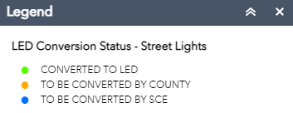
LED Conversion Overview
LED Vs. High Pressure Sodium (HPS)
Energy Efficiency (≈50%)
4X Useful Life
HPS Becoming Obsolete
Progress
Converted ≈ 20,000 (66%)
Across 50+ Communities
Altadena Conversion on Hold

Slide 16
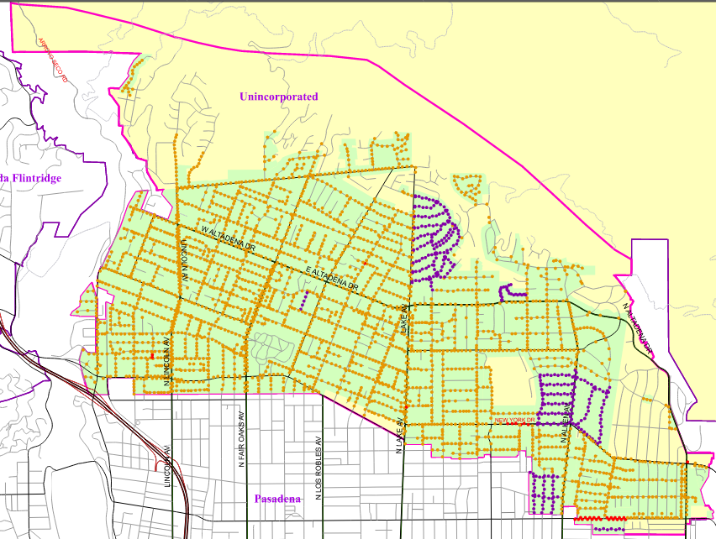
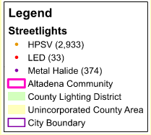
Altadena Streetlight Inventory (By Lamp Type)
Lamp Type
HPS ≈ 2,933 Lamps (88%)
Metal Halide ≈ 374 Lamps (11%)
LED ≈ 33 Lamps (1%)*
*Excludes LED’s at signalized intersections
Canyada Av./Crosby St. (2)
Santa Anita Av./Marigold St. (1)
Lake Av./Morada Pl. (1)
New York Dr. B/W Oxford Av. & Hill Av. (6)
New York Dr./Altadena Dr. (1)
Washington Bl. B/W Allen Av. & Craig Av. (22)

Slide 17
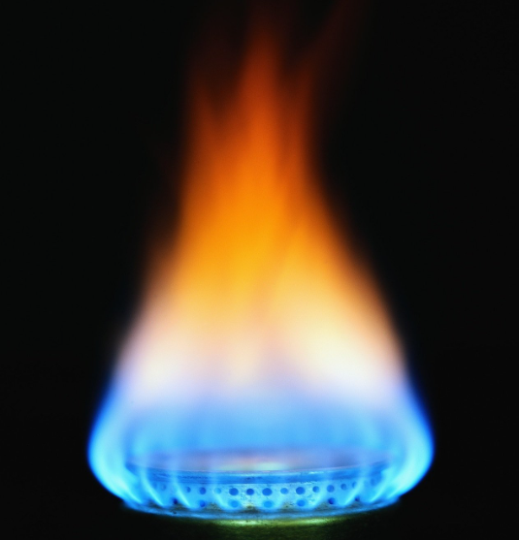
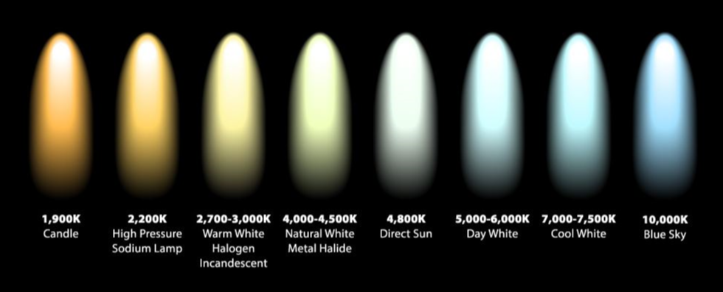
Altadena Conversion (Color Temperature)
Kelvin (K) = Unit of Temperature
County Standard = 2700K
SCE Standard = 3000K
(2700K Option Available)
Both exceed American Medical Association and International Dark-Sky Association Recommendation on Color Temperature

Slide 18
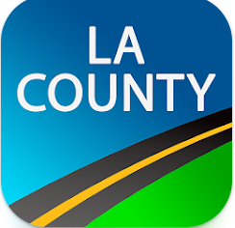
Streetlight Outages/Reporting
County Reporting (Outages, Request Streetlights)
Emergency Dispatch: (800) 675-4357 (HELP)
Streetlight Hotline: (800) 618-7575
Website: www.pw.lacounty.gov/contact
App: The Works App
What Information to Provide:
Required
Issue (i.e. outage, flickering, etc.)
Location of Issue (Nearest address)
Voluntary
Pole Number (recommended)
Name & Phone Number
SCE Reporting (Outages)
Customer Service: (800) 655-4555
Website: www.sce.com/outages
App: MySCE App
Repair Times: Within 5 business days unless the degree of repair requires more time.

Slide 19
Questions?
Contact Information:
Erick Guzman, PE (Project Manager)
eguzman@dpw.lacounty.gov
(626) 300-4860
Victor Lê, PE (Design)
vle@dpw.lacounty.gov
(626) 300-4747

